Slide 1
Query by Humming Searching Sep 23rd
Jiarui Xu(Jerry), Alexander Lerch

Slide 2
This week
Study the Contour Extraction method, programming for extracting the contour.
Program for interval difference sequence detection
Use Yin algorithm to get real time result
Study the HMM method
Build up the baseline

Slide 3

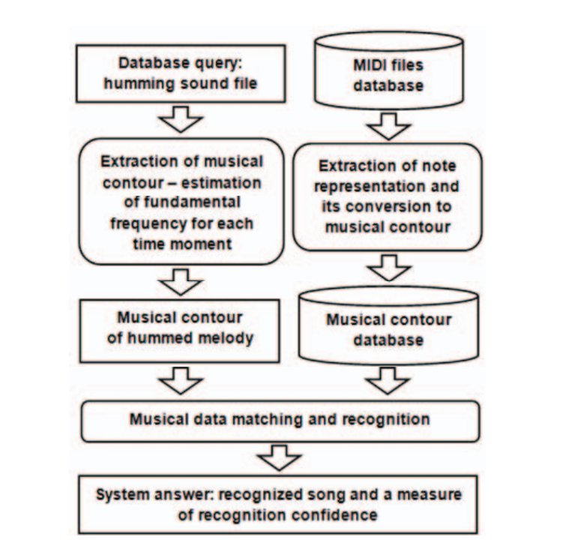
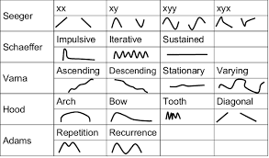
Contour Extraction
Main idea:
Extract frequency->note
Notes’ pitch interval sequence
Compare
Modify to work fast:
Store numeric string instead of individual number
Classify the melody

Slide 4
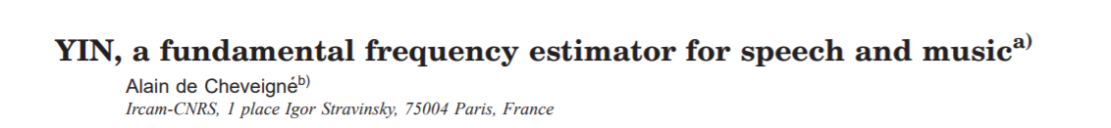
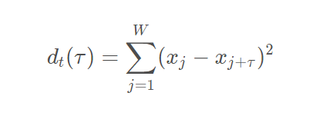
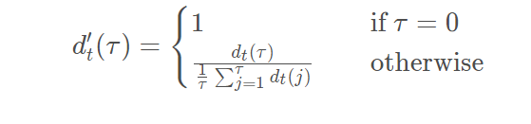
Yin(has realized)
ACF->difference function
Normalize(exclude small period)
Threshold,windows

Slide 5
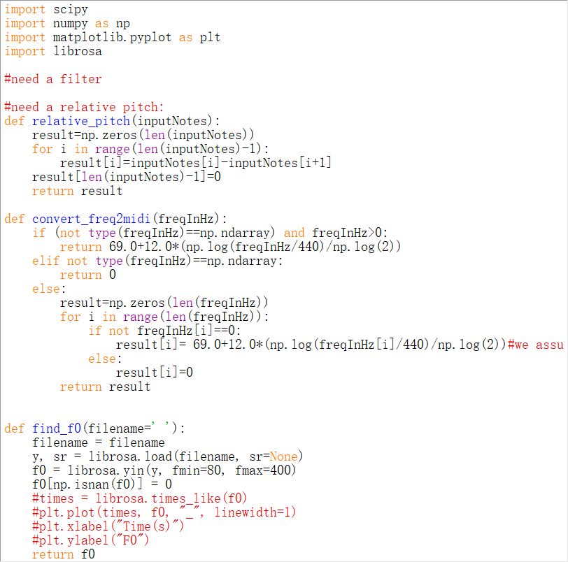
Program
Combine YIN and Contour Extraction together to process the audio file and succeed
Still need evaluation

Slide 6
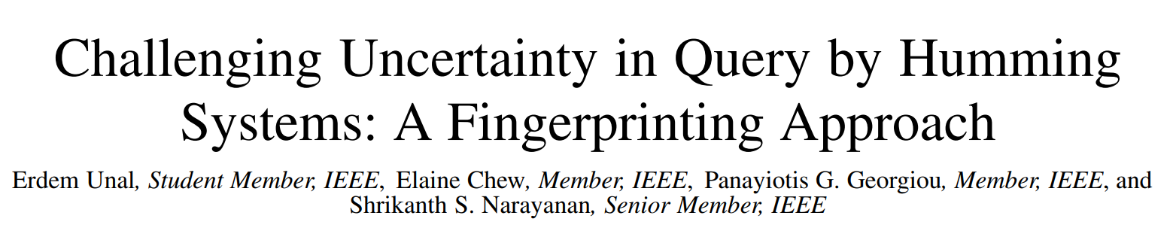
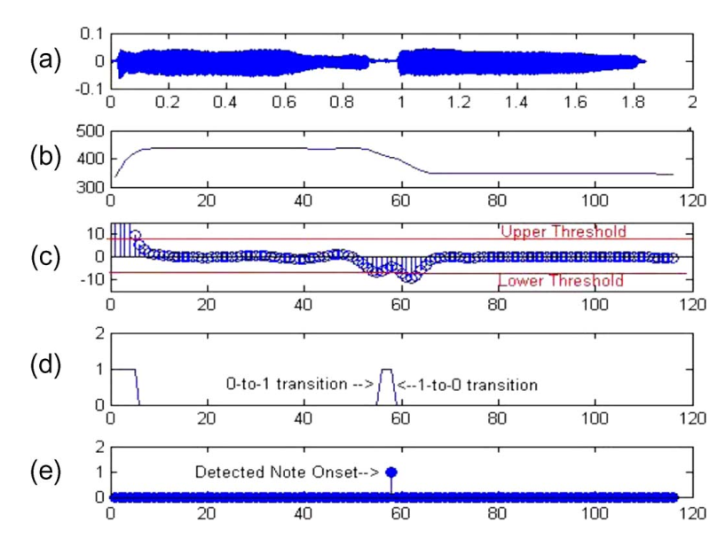
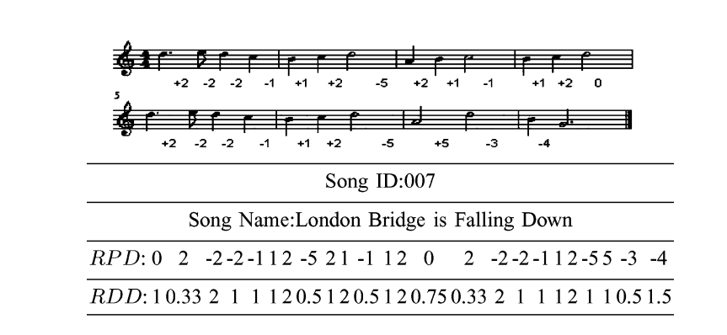
HMM

Slide 7
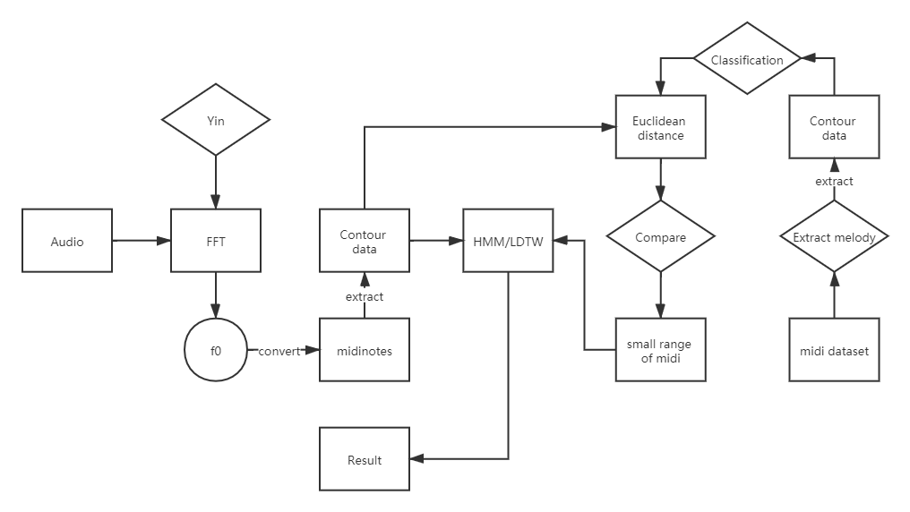
Baseline

Slide 8
Thank you!

